Slide 1
PyTorch Scholarship Challenge Project Showcase
January 11, 2019

Slide 2
Environment Category WINNER:
Deep learning air-pollution forecaster
István Véber & Hackl Krisztián & Dr. Axel Ország-Krisz
(@Axel, @ChrisHackl, @István)

Slide 3
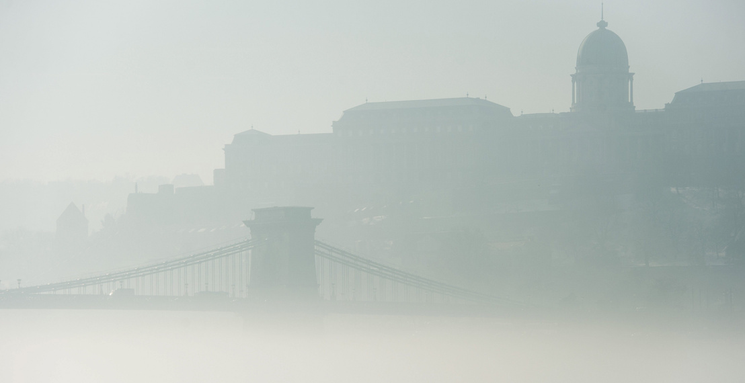
Project Story
PM10
Deep learning air-pollution forecaster
Team members: @Axel, @ChrisHackl, @István
Goal:
Show how to use deep learning for weather related predictions.
We built a model, which is better than the “yesterday=today” forecast.
Key Takeaways:
Similar solutions can be applied to very different domains. (text, weather)
PyTorch is an awesome framework for it! Easy to adjust the model.
Postcard from
Budapest
by Smog
© 2019 Udacity. All rights reserved.

Slide 4
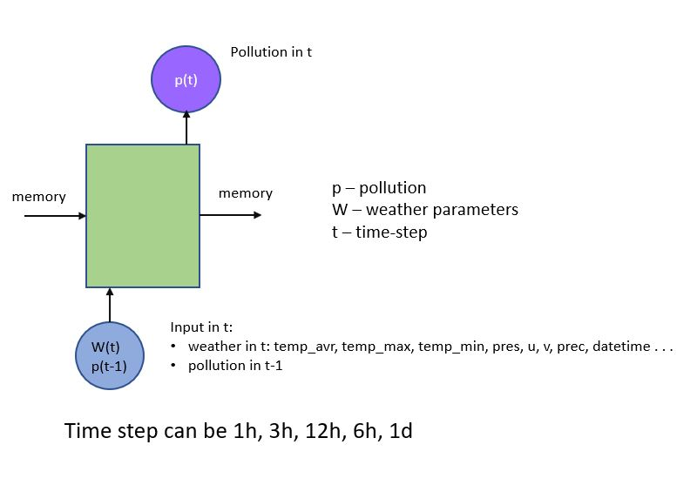
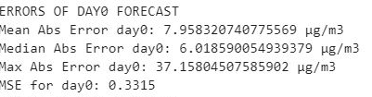

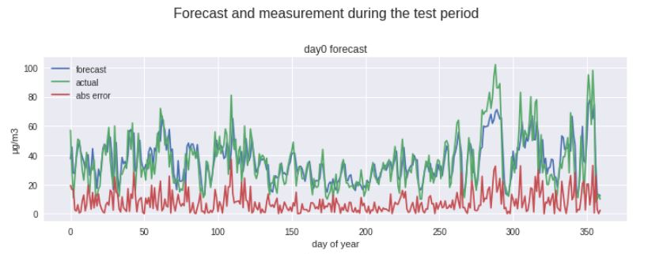
Project Walkthrough
Deep learning air-pollution forecaster
If we know the weather on Tuesday and the pollution on Monday we can calculate the pollution on Tuesday.
Similar to Lesson 7 Character level RNN
© 2019 Udacity. All rights reserved.

Slide 5
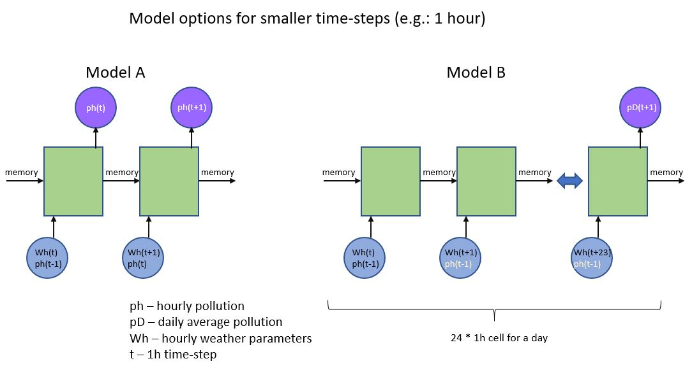
Next Steps
Similar to Lesson 8 Sentiment Analysis RNN (B)
Deep learning air-pollution forecaster
better weather data
data augmentation
multi-station forecast
multi-pollutant forecast
hourly steps
diff. model architectures
test in real weather
train for other cities
website or app
Github: https://github.com/sinusgamma/Deep-learning-air-pollution-forecaster
© 2019 Udacity. All rights reserved.

